Slide 1
Analyzing the Competitiveness of Soccer Leagues
Lesrene Browne
Ammar Abou Hamze
DS2001

Slide 2
TABLE OF CONTENTS
1
2
3
4
Intro & Problem
Methods
We describe the topic and what we mean to find
We discuss the functions we used
Results & Conclusions
Future Work
We discuss things we could try in the future for better results
We discuss our visualizations and what they mean

Slide 3
INTRO & PROBLEM
Soccer is a popular and competitive sport
We wanted to know which soccer league is most competitive between Bundesliga (in Germany), La Liga (in Spain), the Premier League (in the U.K.), and Major League Soccer (in the U.S.)
We wanted to investigate three main measures of competitiveness within each league: average variation in total points, average difference in total points between each position, total points for each league position in comparison to another league

Slide 4
HYPOTHESIS
We expect that the most competitive league is the one that has the least average difference in points between teams, least average variation in points for all teams, and the most points for each league position.

Slide 5
METHODS
league
find_data
This function makes four lists that contain the data from the list from the find_data function categorized by league. The parameter of this function is the data list from the get_data function, which contains a 2d list with the data from all four leagues during the 2019-2020 season. It returned four 2d lists containing the data for each league separately. This function was used to separate the info from one season into separate leagues so we could do calculations with the data from each individual league.
This function reads the entire csv file and makes a list for all information from all 4 leagues associated with the 2019 and 2019/20 season. The parameter that this function takes is a file name. It returns a 2d list with the data from all four leagues that are from the 2019-2020 season. This function was used to get the info from 1 season on which all the other functions rely.

Slide 6
METHODS (cont)
league_dict
This function makes four dictionaries that contain data from the list from the find_data function, specifically each team’s position in a league and their total points, categorized by league. The parameter of this function is the data list from the get_data function, which contains a 2d list with the data from all four leagues during the 2019-2020 season. It returns four dictionaries containing the data for each league (team_league_position : team_total_points) separately. This function was used to separate the info from one season into separate leagues so we could do calculations with the data from each individual league.

Slide 7
METHODS (cont)
avg
This function finds the points averaged in one league. The parameter for the function is the league data from the league_dict function (each team’s position in a league and their total points) and returns the standard deviation of the points. The function extracts the points from the dictionary provided, adds the extracted points to a list, sorts the points in descending order, converts the points list to an array, and then finds the average using numpy. We used this function to make a y-line on our graph showing position vs final points. It helps to better understand our variation bar graph.

Slide 8
METHODS (cont)
get_var
This function gets the standard deviation between each team’s total points for one league. The parameter this function takes is the league data from the league_dict function (each team’s position in a league and their total points) and returns the standard deviation of the points. The function extracts the points from the dictionary provided, adds the extracted points to a list, sorts the points in descending order, converts the points list to an array, finds the variance using numpy, then square roots the variance to find the standard deviation. This function was used to calculate the average difference in points relative to the average points overall which we translated into a bar graph where we compared the variation from average total points for each league.

Slide 9
METHODS (cont)
get_avg_diff
This function gets the average difference of total points of each team from one league. The parameter of the function is the league data from the league_dict function (each team’s position in a league and their total points) and returns the average difference in points between teams. This function was used to calculate the average difference in points between a league’s teams which we translated into a bar graph showing how close each league’s teams were in points on average.

Slide 10
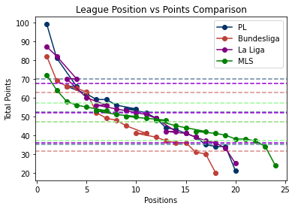
RESULTS

Slide 11
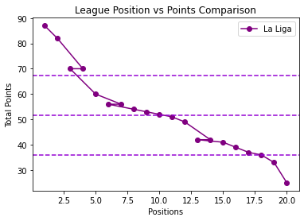
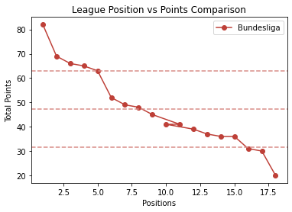
RESULTS

Slide 12
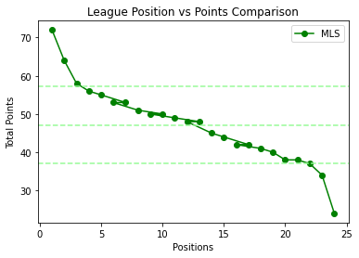
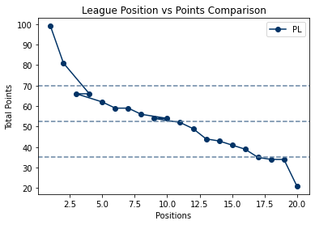
RESULTS

Slide 13
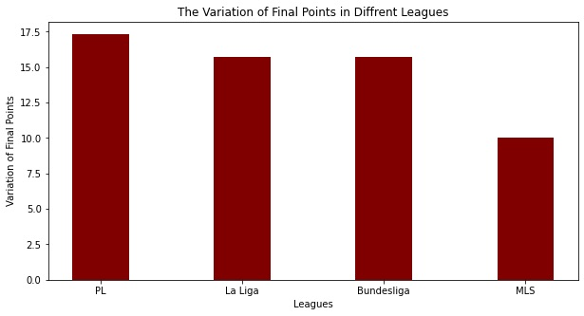
RESULTS

Slide 14
CONCLUSIONS
These visualizations show that Major League Soccer has the least variation in the total points each team gets at the end of the 2019/20 Season.
These visualizations also show that Major League Soccer had the least average difference of total points between each position during the 2019/20 season.
The teams in Premier League’s highest positions had the highest points for each position for the most part.

Slide 15
CONCLUSIONS
After careful examination, we discovered that the MLS does not follow a traditional soccer league schedule
Since comparing this league to the others would not be accurate, we have decided to disregard the MLS’s results and focus on the other three leagues; Premier League, Bundesliga and La Liga. After disregarding the MLS data we concluded that La Liga is the most competitive league because it had the least average difference in points between positions by a significant margin and it also had a relatively small variation in total points. They also had the second highest amount of points per position.

Slide 16
FUTURE WORK
We could explore competitiveness over more than one season or we could explore other European Leagues such as Serie A or Ligue 1
We also could have made our graph showing how a team in a specific position in one league compares directly to a team the same position in terms of total points more easily readable
We also could have examined details about each match played by each team such as the number of goals or the total points of the teams after certain times in the season.

Slide 17
WORKS CITED
Nguyen. (2020) Bundesliga, La Liga, MLS, & Premier League Data [Dataset] Retrieved from https://www.kaggle.com/taranguyen/form-in-bundesliga-la-liga-mls-premier-league.

Slide 18
Thank You !!
Any Questions?

